Slide 1


AI Agents Inside IDEs: Practice and Possibilities
Yaroslav Zharov, JetBrains Research
Notes:
I will talk about things that I consider interesting to know for those developing agents. There will be a second presentation with a short survey of some specific approaches that might be interesting.

Slide 2
A Lot of Exciting Things Are Made with AI Agents in IDEs
Notes:
Users prefer something understandable rather than very precise. Therefore, if you show to user what an agent does, it may be worth to select something that looks smart, even if it’s not the smartest on average.

Slide 3
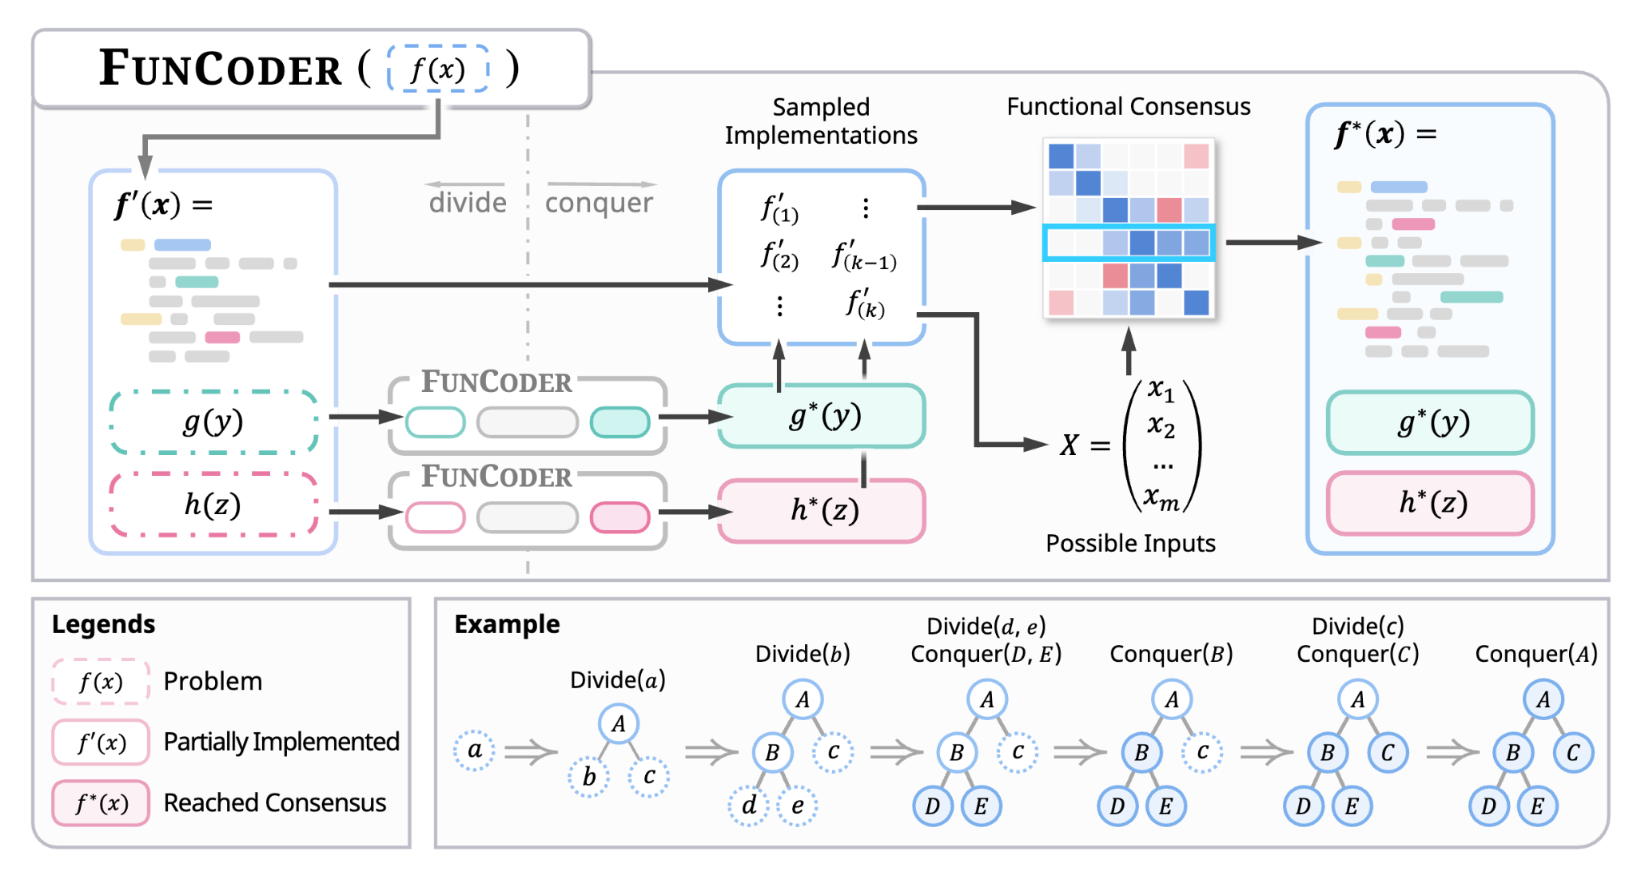
FunCoder (Chen et al., 2024)
Notes:
First generate a tree of functions. Then re-implement from bottom, sample several implementations and select such implementations, that have better “functional consensus” – same inputs result in same outputs.

Slide 4
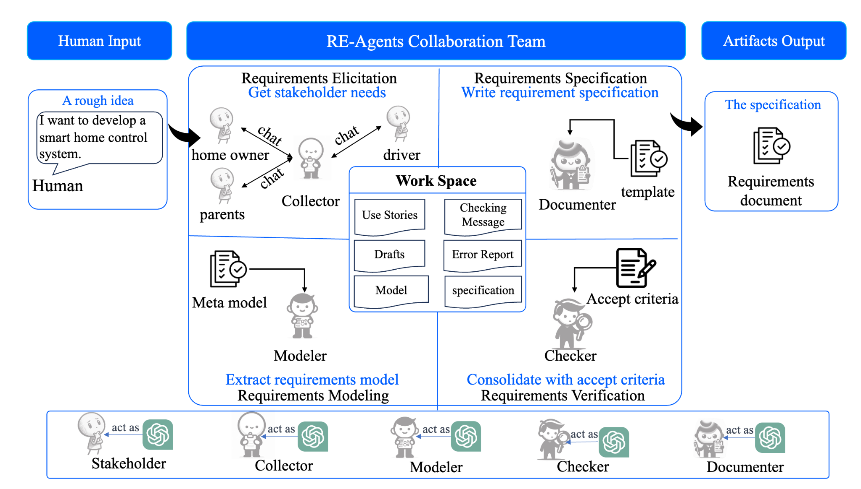
MARE (Jin et al., 2024)
Notes:
The memory constrained to a real format of the documentation in teams

Slide 5
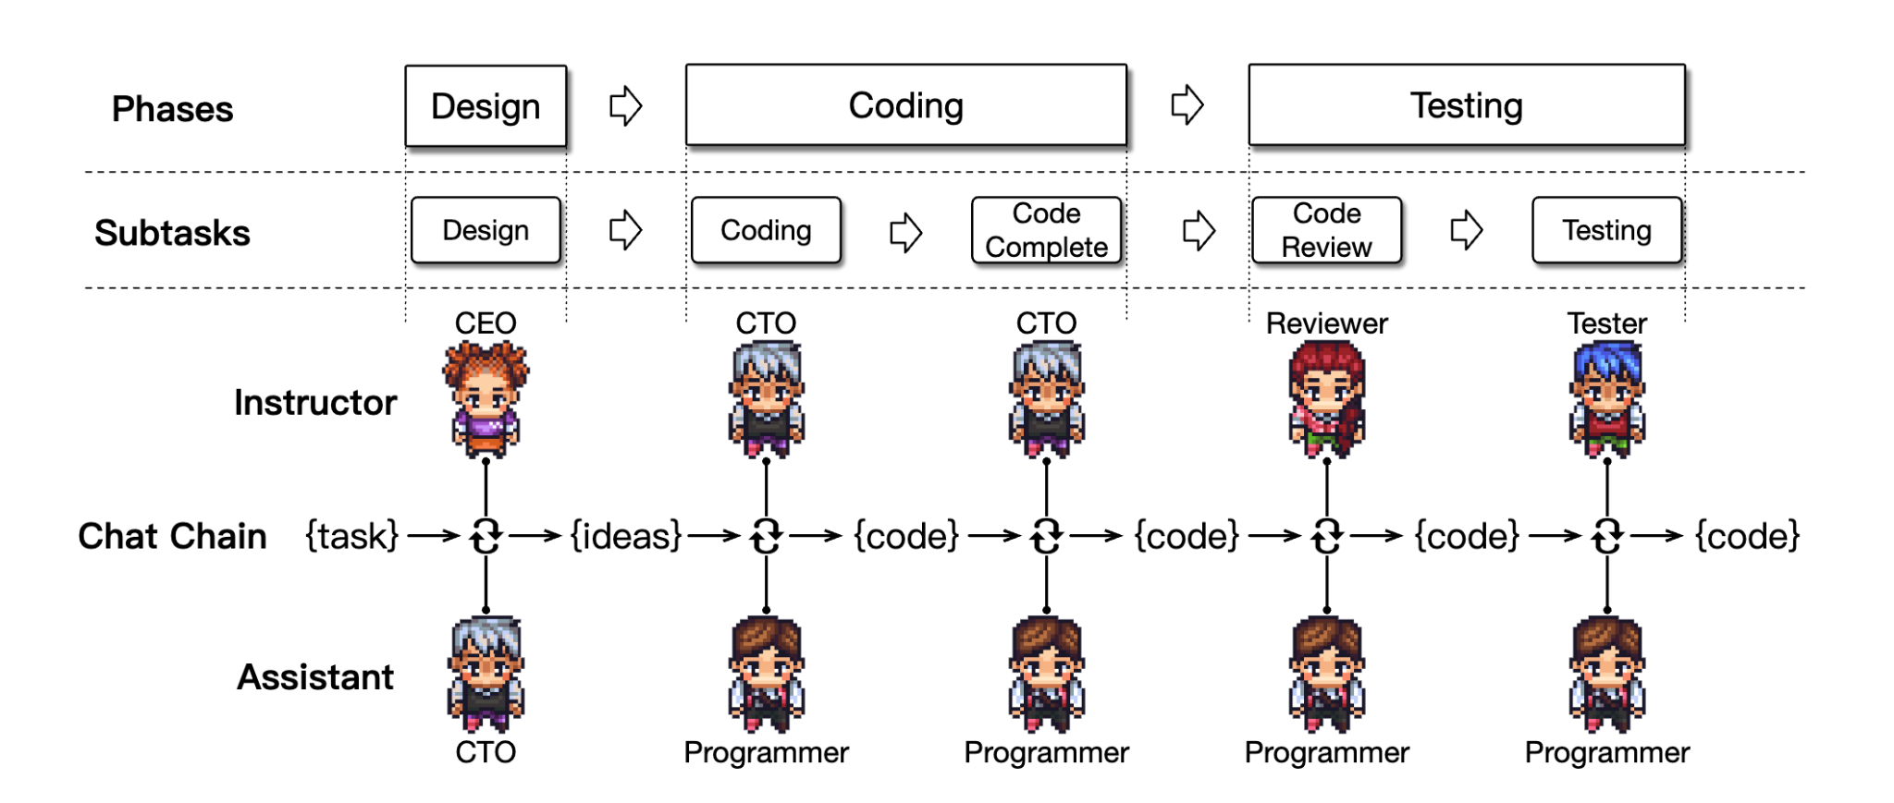
ChatDev (Chen et al., 2024)
MetaGPT (Hong et al., 2024), AgileCoder (Nguyen et al., 2024), etc.
Notes:
A ton of agents cosplaying a dev team.

Slide 6
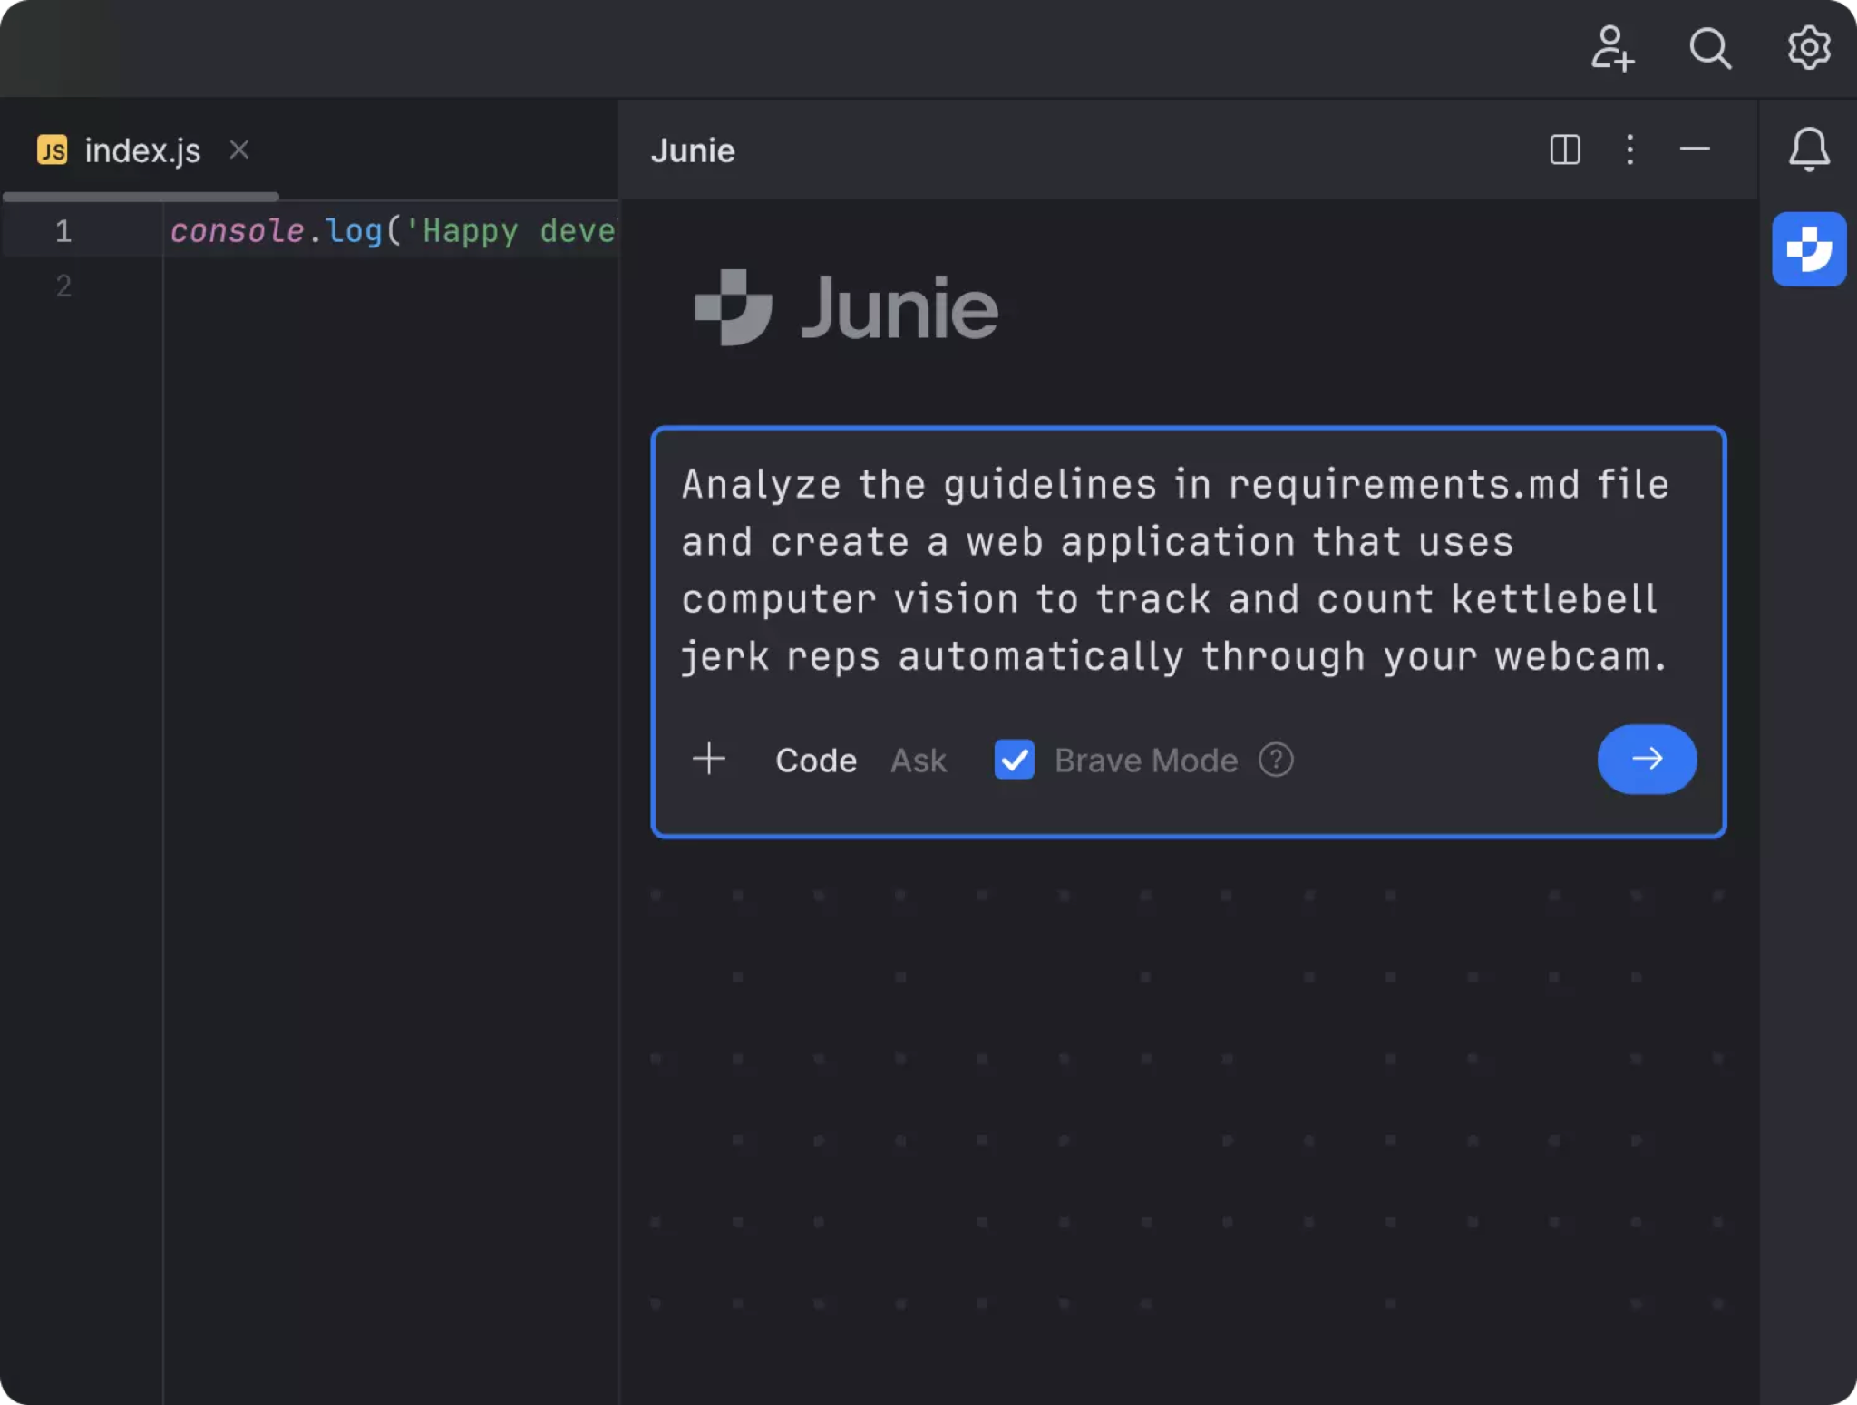
Junie
Notes:
A ton of agents cosplaying a dev team.

Slide 7
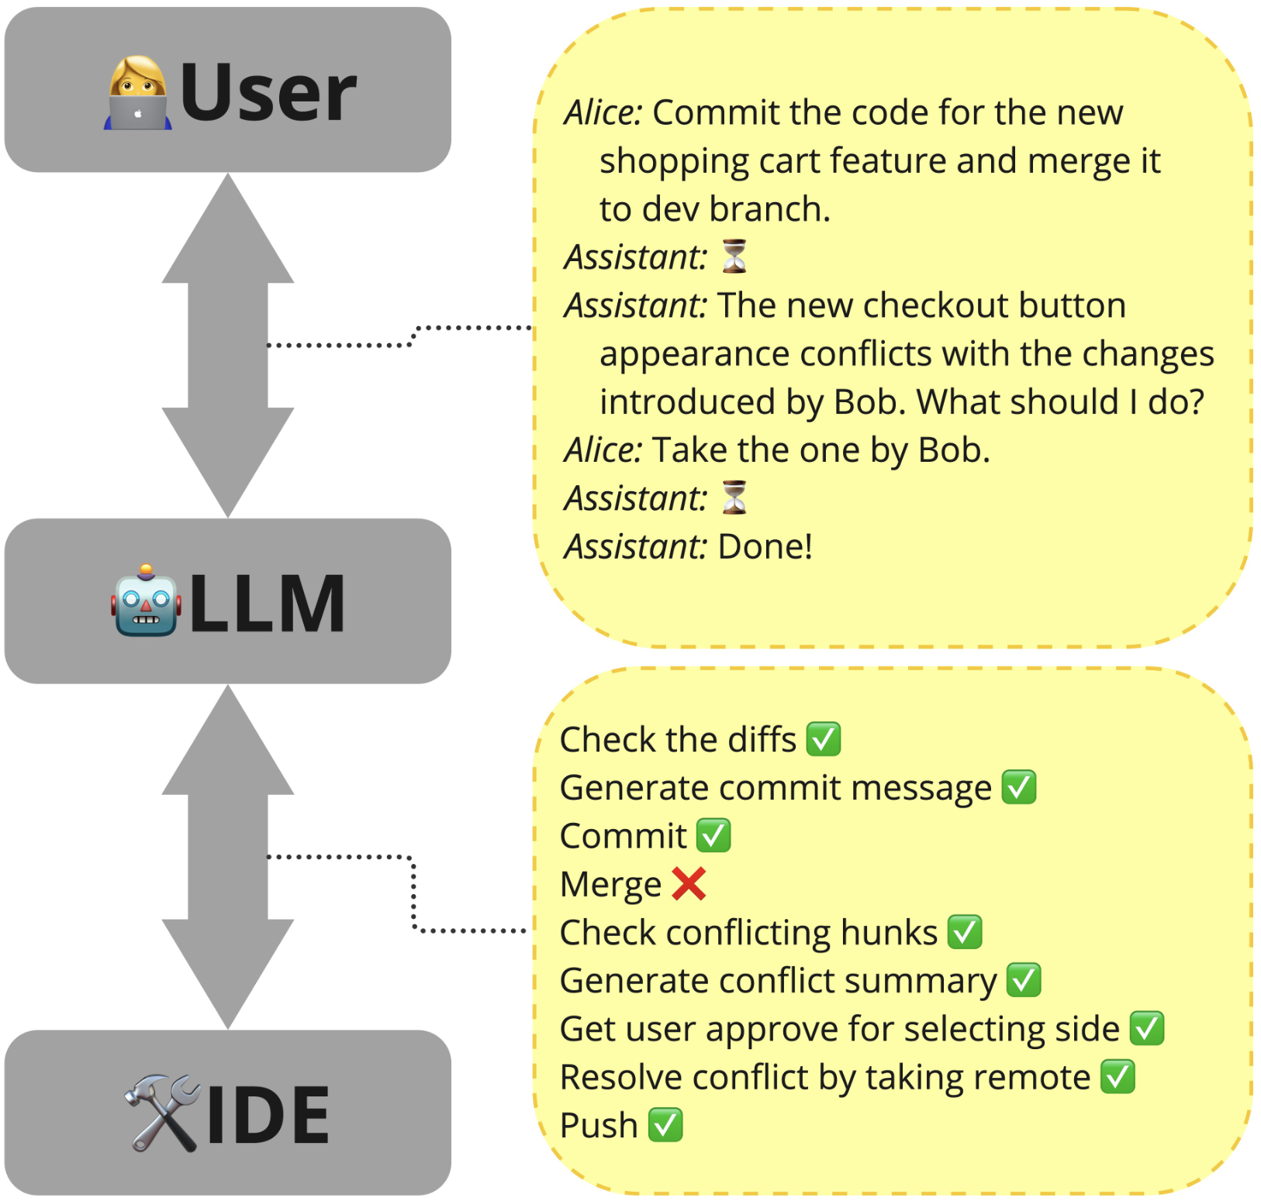
Agents are Universal IDE Interfaces
Notes:
To keep the template design consistent, please paste text from another source using Paste without formatting (right-click or menu Edit).
Please take note that presentations are intended to help the audience focus on the speaker’s words rather than distract them with detailed reading material.
Each slide should use only a handful of words to reiterate the speaker’s points using text that reinforce the speaker’s point.
Avoid inserting so much text that you have to decrease the font size.
If your text does not fit in the text placeholder, consider breaking it into 2 slides or choosing a layout with 2 or 3 columns.

Slide 8
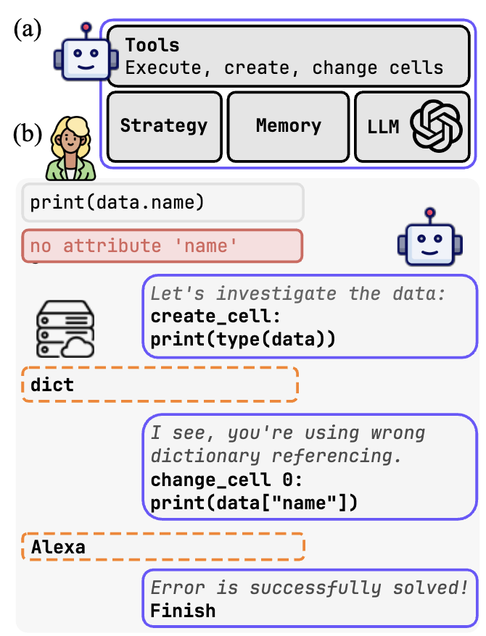
Notebook Debugging
(Grotov et. al, 2024)
Notes:
To keep the template design consistent, please paste text from another source using Paste without formatting (right-click or menu Edit).
Please take note that presentations are intended to help the audience focus on the speaker’s words rather than distract them with detailed reading material.
Each slide should use only a handful of words to reiterate the speaker’s points using text that reinforce the speaker’s point.
Avoid inserting so much text that you have to decrease the font size.
If your text does not fit in the text placeholder, consider breaking it into 2 slides or choosing a layout with 2 or 3 columns.

Slide 9
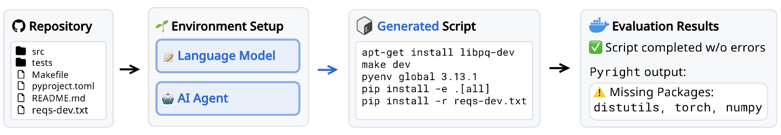
Setting up Environment
(Eliseeva et. al, 2024)
Notes:
To keep the template design consistent, please paste text from another source using Paste without formatting (right-click or menu Edit).
Please take note that presentations are intended to help the audience focus on the speaker’s words rather than distract them with detailed reading material.
Each slide should use only a handful of words to reiterate the speaker’s points using text that reinforce the speaker’s point.
Avoid inserting so much text that you have to decrease the font size.
If your text does not fit in the text placeholder, consider breaking it into 2 slides or choosing a layout with 2 or 3 columns.

Slide 10
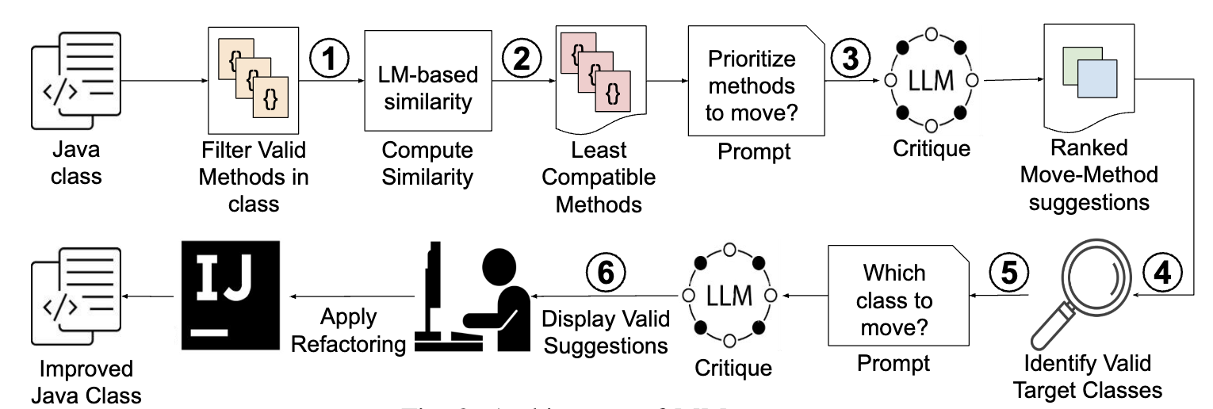
Automating Move Method Refactorings (Batole et. al, 2025)
Notes:
To keep the template design consistent, please paste text from another source using Paste without formatting (right-click or menu Edit).
Please take note that presentations are intended to help the audience focus on the speaker’s words rather than distract them with detailed reading material.
Each slide should use only a handful of words to reiterate the speaker’s points using text that reinforce the speaker’s point.
Avoid inserting so much text that you have to decrease the font size.
If your text does not fit in the text placeholder, consider breaking it into 2 slides or choosing a layout with 2 or 3 columns.

Slide 11
And There Are More
VCS interaction
Documentation writing
Code profiling and optimization
Interaction with CI systems
Notes:
To keep the template design consistent, please paste text from another source using Paste without formatting (right-click or menu Edit).
Please take note that presentations are intended to help the audience focus on the speaker’s words rather than distract them with detailed reading material.
Each slide should use only a handful of words to reiterate the speaker’s points using text that reinforce the speaker’s point.
Avoid inserting so much text that you have to decrease the font size.
If your text does not fit in the text placeholder, consider breaking it into 2 slides or choosing a layout with 2 or 3 columns.

Slide 12
A Lot of Exciting Things Aren’t Yet Made with AI Agents in IDEs
Let’s make it happen
Notes:
Users prefer something understandable rather than very precise. Therefore, if you show to user what an agent does, it may be worth to select something that looks smart, even if it’s not the smartest on average.

Slide 13
Next in This Talk
A gentle intro to AI agents.
Practical notes on AI agents development.
What I expect from AI agents.
Notes:
To keep the template design consistent, please paste text from another source using Paste without formatting (right-click or menu Edit).
Please take note that presentations are intended to help the audience focus on the speaker’s words rather than distract them with detailed reading material.
Each slide should use only a handful of words to reiterate the speaker’s points using text that reinforce the speaker’s point.
Avoid inserting so much text that you have to decrease the font size.

Slide 14
A Gentle Intro to AI Agents —
Notes:
To keep the template design consistent, please paste text from another source using Paste without formatting (right-click or menu Edit). use only one type of separator (section) within one presentation

Slide 15
Main Components of AI Agents
AI model
Planning
Memory
Knowledge
Tools
Notes:
To keep the template design consistent, please paste text from another source using Paste without formatting (right-click or menu Edit).
Please take note that presentations are intended to help the audience focus on the speaker’s words rather than distract them with detailed reading material.
Each slide should use only a handful of words to reiterate the speaker’s points using text that reinforce the speaker’s point.
Avoid inserting so much text that you have to decrease the font size.
If your text does not fit in the text placeholder, consider breaking it into 2 slides or choosing a layout with 2 or 3 columns.

Slide 16
AI Models as Decision-Making Engines
Proprietary LLMs (GPT, Claude, Gemini, etc)
OpenWeights LLMs (Llama, Qwen, DeepSeek, etc)
Fine-tuned LLMs
Custom ML models for specific scenarios
Notes:
To keep the template design consistent, please paste text from another source using Paste without formatting (right-click or menu Edit).
Please take note that presentations are intended to help the audience focus on the speaker’s words rather than distract them with detailed reading material.
Each slide should use only a handful of words to reiterate the speaker’s points using text that reinforce the speaker’s point.
Avoid inserting so much text that you have to decrease the font size.
If your text does not fit in the text placeholder, consider breaking it into 2 slides or choosing a layout with 2 or 3 columns.

Slide 17
Planning
for loop
Universal strategies
Workflows
Engineering complexity
Accountability
Notes:
To keep the template design consistent, please paste text from another source using Paste without formatting (right-click or menu Edit).
Please take note that presentations are intended to help the audience focus on the speaker’s words rather than distract them with detailed reading material.
Each slide should use only a handful of words to reiterate the speaker’s points using text that reinforce the speaker’s point.
Avoid inserting so much text that you have to decrease the font size.
If the text does not fit, consider breaking it into 2 slides.

Slide 18
Knowledge
How to make model know the environment?
RAG
Test Time Data
Prompt Engineering
Fine-Tuning
Train Time Data
Notes:
To keep the template design consistent, please paste text from another source using Paste without formatting (right-click or menu Edit).
Please take note that presentations are intended to help the audience focus on the speaker’s words rather than distract them with detailed reading material.
Each slide should use only a handful of words to reiterate the speaker’s points using text that reinforce the speaker’s point.
Avoid inserting so much text that you have to decrease the font size.
If the text does not fit, consider breaking it into 2 slides.

Slide 19
Memory
How to make model remember the past?
Chat
Compressed chat
Memory pad
Complexity
Token Consumption
Notes:
To keep the template design consistent, please paste text from another source using Paste without formatting (right-click or menu Edit).
Please take note that presentations are intended to help the audience focus on the speaker’s words rather than distract them with detailed reading material.
Each slide should use only a handful of words to reiterate the speaker’s points using text that reinforce the speaker’s point.
Avoid inserting so much text that you have to decrease the font size.
If the text does not fit, consider breaking it into 2 slides.

Slide 20
Tools
Raw API
Engineered tools
Engineering complexity
Performance
Notes:
To keep the template design consistent, please paste text from another source using Paste without formatting (right-click or menu Edit).
Please take note that presentations are intended to help the audience focus on the speaker’s words rather than distract them with detailed reading material.
Each slide should use only a handful of words to reiterate the speaker’s points using text that reinforce the speaker’s point.
Avoid inserting so much text that you have to decrease the font size.
If the text does not fit, consider breaking it into 2 slides.

Slide 21
Practical Notes on
AI Agents Development —
Notes:
To keep the template design consistent, please paste text from another source using Paste without formatting (right-click or menu Edit). use only one type of separator (section) within one presentation

Slide 22
Where to use AI agents?
Find a task where you can outline an algorithm of a solution, but can not automate it right away
Notes:
This Question & answer slide is ideal for presenting short questions and answers.
To keep the template design consistent, please paste text from another source using Paste without formatting (right-click or menu Edit).

Slide 23
People Have Narrative Bias
Online agents—low variance
Offline agents—low bias
Notes:
Users prefer something understandable rather than very precise. Therefore, if you show to user what an agent does, it may be worth to select something that looks smart, even if it’s not the smartest on average.

Slide 24
How To Scale With Agents?
Get Offline
Get Verifier
Get Ensemble
Tasks like babysitting builds, checking the pull requests, and fixing low priority problems.
If you can verify your results in one or another way without asking the user—do it.
Run a bunch of models with low bias (high variance acceptable, e.g., reasoning), aggregate for best solution.

Slide 25
How To Do Online Agents?
Coherence
Repetitive Petty Tasks
Keep User In Charge
Most practitioners still do agentic flows, not fully agentic solutions.
Also, select predictable models.
Small things are easier to roll back, so the cost of mistake goes down.
Users like to be able to correct some intermediate steps.
Check if model knows what it should and doesn’t assume.

Slide 26
What I Expect
From AI Agents —
Notes:
To keep the template design consistent, please paste text from another source using Paste without formatting (right-click or menu Edit). use only one type of separator (section) within one presentation

Slide 27
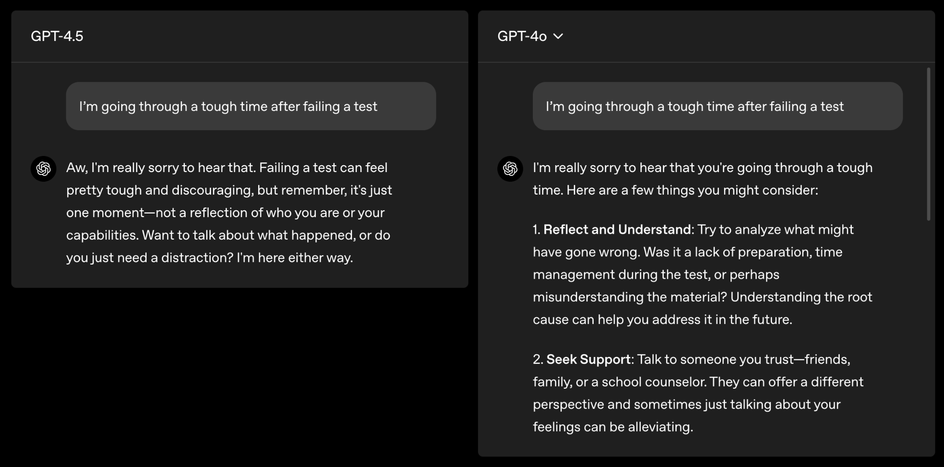
Better Aligned models
Notes:
To keep the template design consistent, please paste text from another source using Paste without formatting (right-click or menu Edit).
Please take note that presentations are intended to help the audience focus on the speaker’s words rather than distract them with detailed reading material.
Each slide should use only a handful of words to reiterate the speaker’s points using text that reinforce the speaker’s point.
Avoid inserting so much text that you have to decrease the font size.
If your text does not fit in the text placeholder, consider breaking it into 2 slides or choosing a layout with 2 or 3 columns.

Slide 28
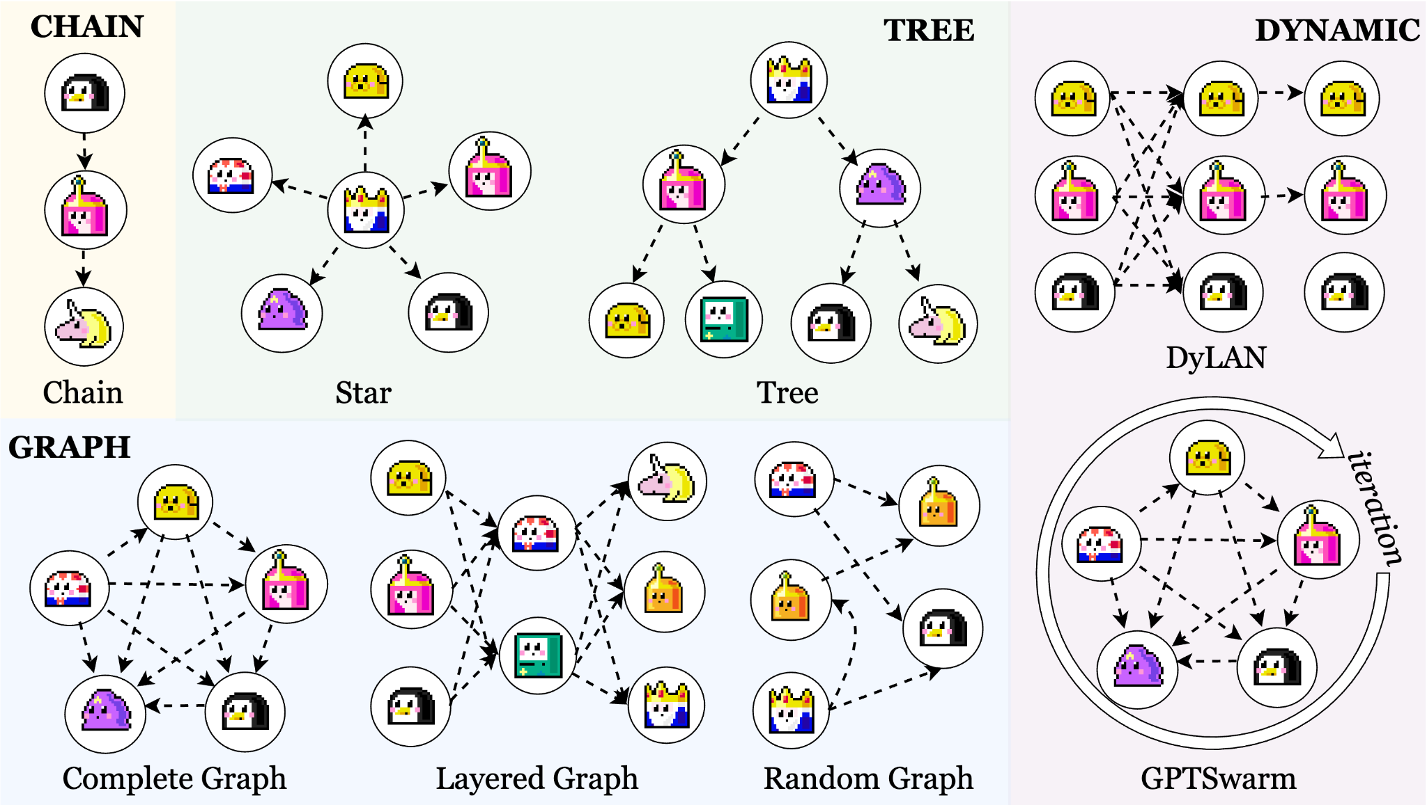
Multiagent Architectures
Notes:
To keep the template design consistent, please paste text from another source using Paste without formatting (right-click or menu Edit).
Please take note that presentations are intended to help the audience focus on the speaker’s words rather than distract them with detailed reading material.
Each slide should use only a handful of words to reiterate the speaker’s points using text that reinforce the speaker’s point.
Avoid inserting so much text that you have to decrease the font size.
If your text does not fit in the text placeholder, consider breaking it into 2 slides or choosing a layout with 2 or 3 columns.

Slide 29
Evaluating Agents
Contamination
Measuring Somewhat Wrong Thing
SWE-bench SoTA: 64.6%
Konwinski Prize SoTA: 10%
And googling on top of it.
We still mostly measure outcome as if it was a one-shot execution.
Metrics should take into account time, autonomy, quality of trajectory.

Slide 30
Lower Level Interactions
Models will better understand low-level modalities
Code
Web
Text tools -> Code tools -> AST
Screenshot -> DOM -> API
Notes:
To keep the template design consistent, please paste text from another source using Paste without formatting (right-click or menu Edit).
Please take note that presentations are intended to help the audience focus on the speaker’s words rather than distract them with detailed reading material.
Each slide should use only a handful of words to reiterate the speaker’s points using text that reinforce the speaker’s point.
Avoid inserting so much text that you have to decrease the font size.
If the text does not fit, consider breaking it into 2 slides.

Slide 31
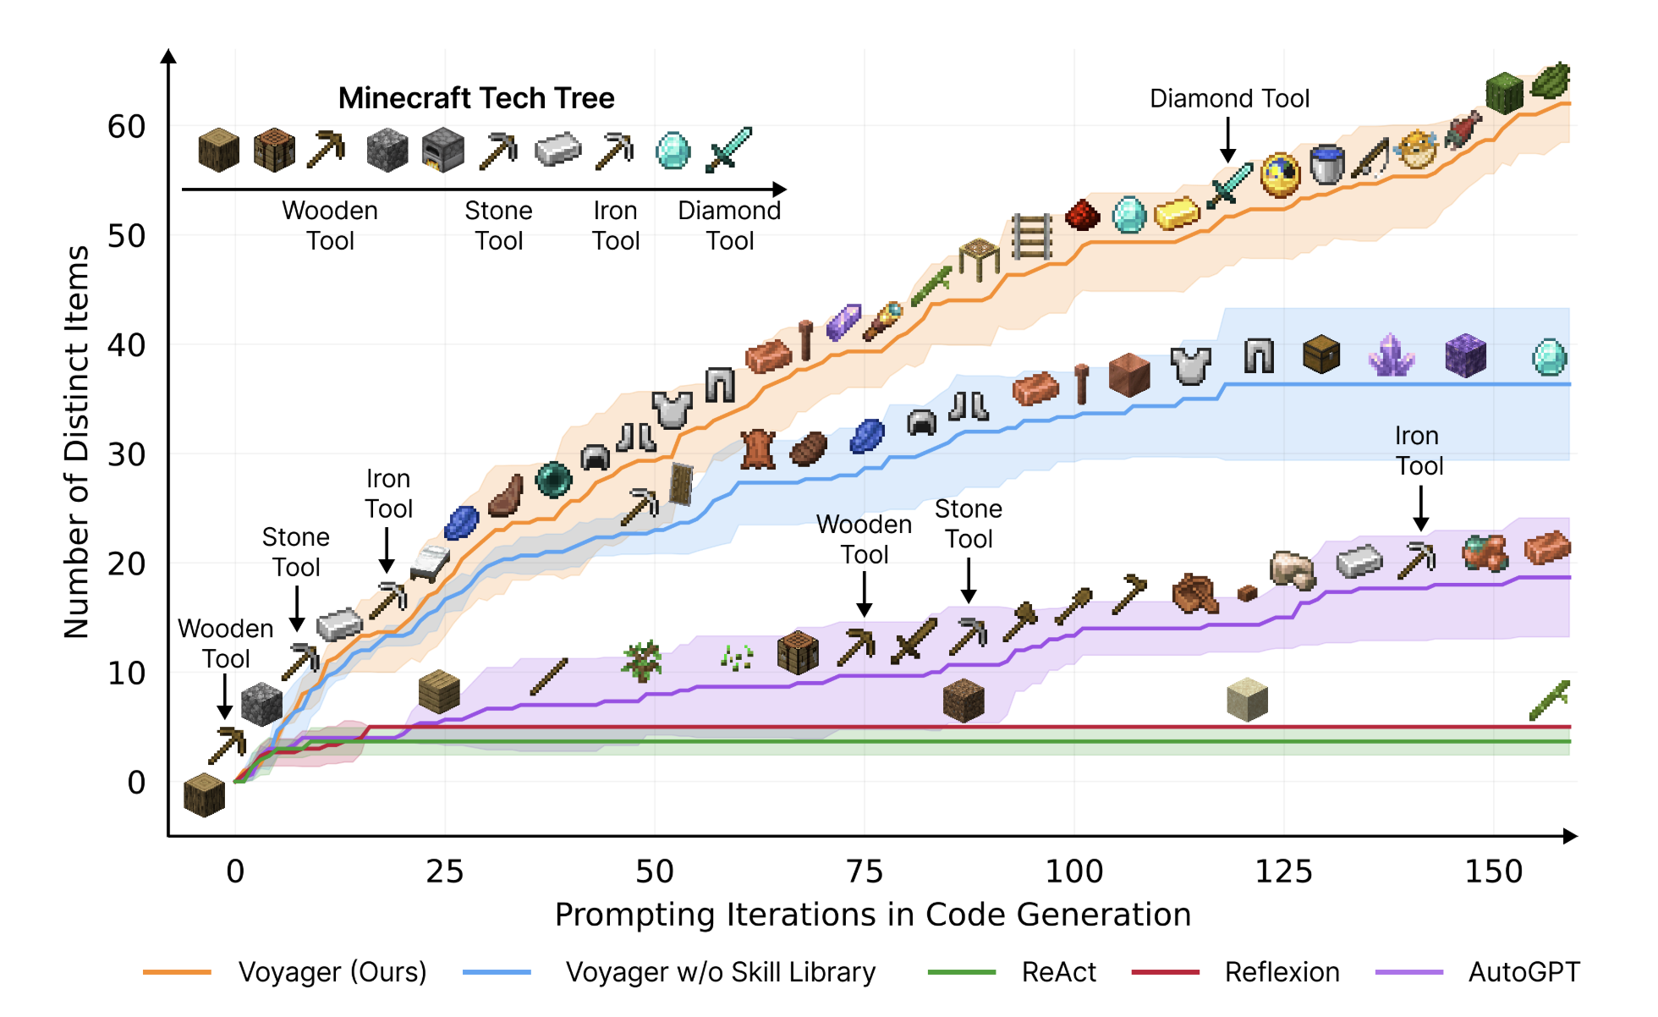
Advanced Tool Usage
Custom models training/prompting
One tool at a time
Set of tools
Code with tools as APIs
Saved subroutines

Slide 32

Thank you!
Yaroslav Zharov
yaroslav.zharov@jetbrains.com
Notes:
This is a Closing slide that is ideal for ending your presentation.
To keep the template design consistent, please paste text from another source using Paste without formatting (right-click or menu Edit).

